Slide 2


Gopinath J
Chief Digital Officer
Ganesh Kanna Subramanian
Architect

Slide 3


Slide 4
Kotlin Multiplatform Mobile Simplifying Mobile Application Development

Slide 5

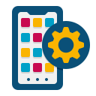
Kotlin Multiplatform Mobile
Mobile Features
Kotlin Multiplatform

Slide 6




Mobile Application Development
Cross Platform
Native Android and iOS

Slide 7
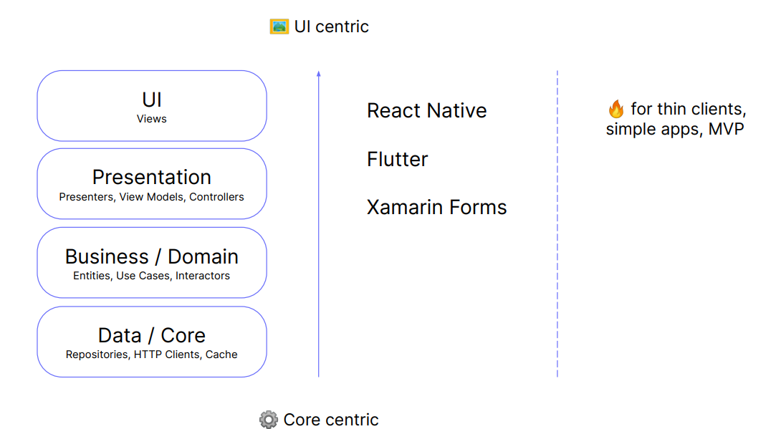
Why Kotlin Multiplatform Mobile?

Slide 8
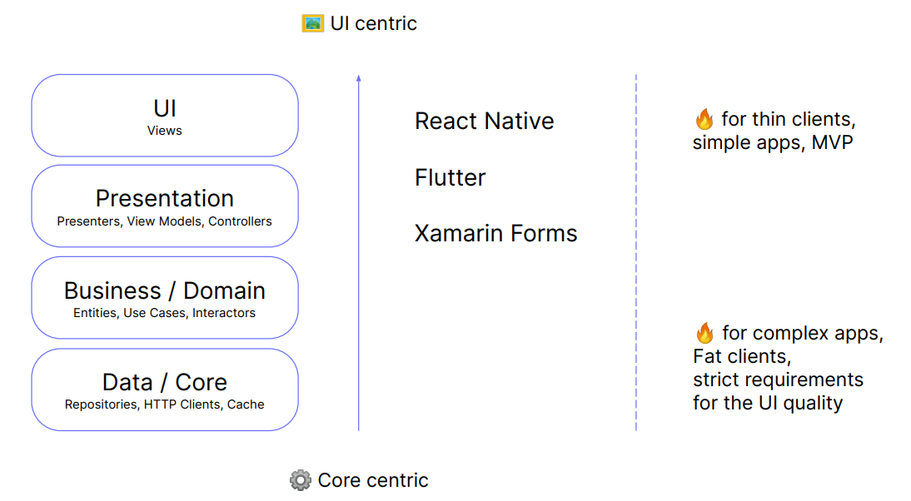
Why Kotlin Multiplatform Mobile?

Slide 9
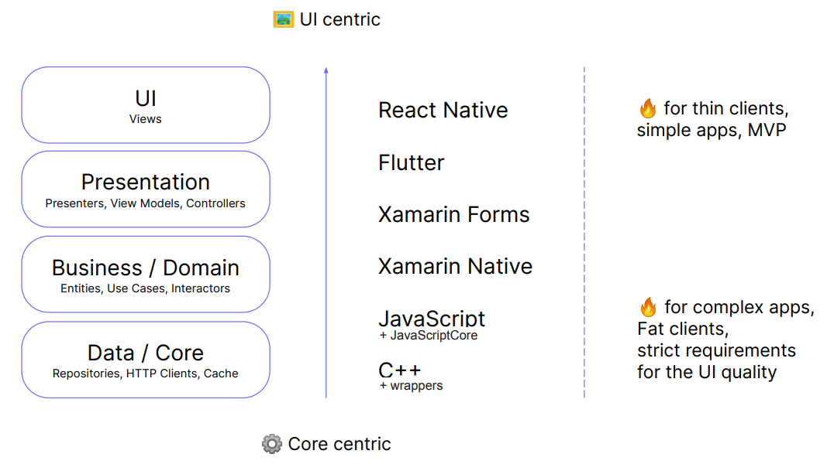
Why Kotlin Multiplatform Mobile?

Slide 10
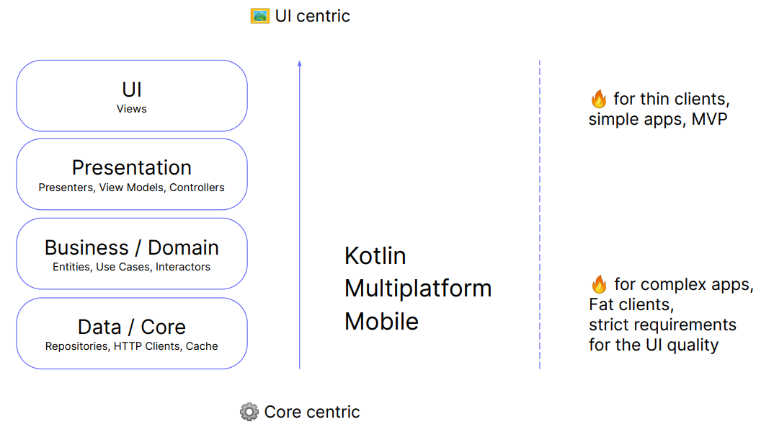
Why Kotlin Multiplatform Mobile?

Slide 11




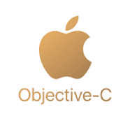

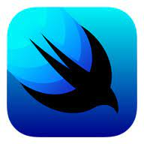
Native Android and IOS
Native Android (Java/Kotlin)
iOS (Objective C/Swift)
Launch
There are other libraries that are available to help developer to quickly native mobile application such as Jetpack Compose for Android and Swift UI for iOS

Slide 12

Cross Platform
Flutter and React-Native are most widely used frameworks now in the community
Another notable frame works such as Cordova-Ionic, Xamarin
Flutter - One source code where we can build application for Mobile (iOS/Android, Web and Desktop as well)

Slide 13
What is Kotlin Multiplatform Mobile
It allows app developers to reuse codebase like cross-platform and keeping the app native
Kotlin Multiplatform Mobile, a new Framework that combines best of both worlds

Slide 14




Kotlin Multiplatform Mobile Benefits
Shared, testable architecture (Not UI)
Smooth interop, optional code sharing
Bonus! One platform 100% Native
Active community
Good Tools

Slide 15
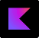
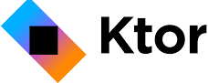



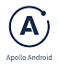

Official Libraries
Serialization
Ktor
Many modern Android libraries already have multiplatform support, like Koin, Apollo, and Okio.
Coroutines
Lincheck

Slide 16
Kotlin Multiplatform Mobile Module
.framework
.jar

Slide 17
Comparison between Kotlin Multiplatform Mobile and Other Class Platform

Slide 18
UI
FLUTER
REACT NATIVE
Kotlin Multiplatform Mobile
Components of React Native are mapped to Native components of respective platform, means native look and feel
UI is coded separately for Android and IOS using native code
Common UI for both Android and IOS

Slide 19
Business Logic
FLUTER
REACT NATIVE
Kotlin Multiplatform Mobile
Written in Dart common to both platforms
Written in JS common to both platforms
Written in Kotin and common for both platforms

Slide 20
Layered Architecture
FLUTER
REACT NATIVE
Kotlin Multiplatform Mobile
Written in Dart common to both platforms
Written in JS common to both platforms
Written in Kotlin and common for both platforms

Slide 21

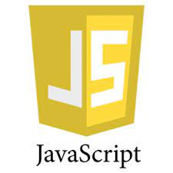
Interoperability
Kotlin can interop with java and other languages also.
But in the case of Flutter, we have to stick to Dart only and
React Native we have to stick with js only

Slide 22


Easy to go native
At any level of coding
In Kotlin Multiplatform Mobile it is very easy to write native code
At any layer of the architecture

Slide 23


Integration with existing Projects
Kotlin Multiplatform Mobile has the power to get integrated with any existing project
But in Flutter or React Native we have to keep going with their own infrastructure

Slide 24




Kotlin Multiplatform Mobile will be a good choice if...
You care about having the most updated native components and want to have a 100% native look and feel on every new OS version.
You don't want to depend on Flutter engine's implementation on each platform.
Already have existing native-specific code to be reused.
You want to incrementally share code between platforms on an existing codebase.
Your app is strongly tied to multi-thread or it has background processing needs.

Slide 25
Kotlin Multiplatform Mobile Architecture

Slide 27
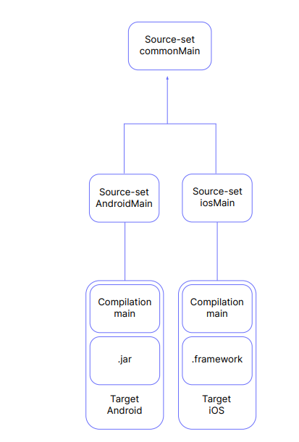

Slide 28
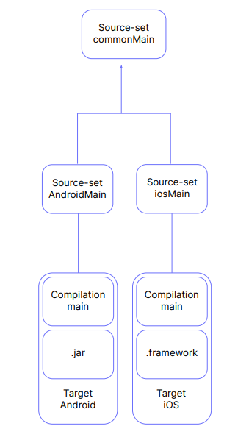

Slide 29
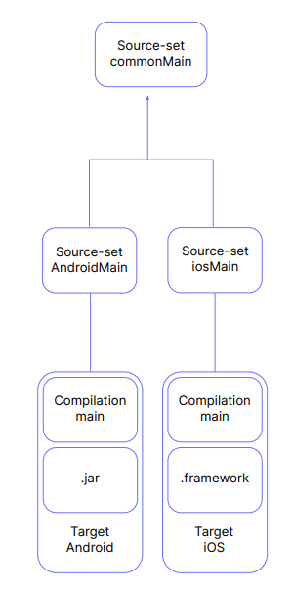

Slide 30
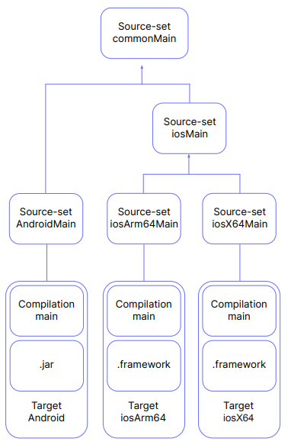

Slide 31
Mobile Application
Demonstrate Kotlin Multiplatform Mobile Capability

Slide 32

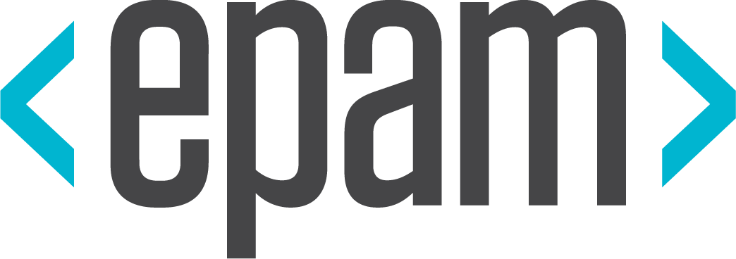




Platinum Partner
Gold Partner
Silver Partner

Slide 34
Kotlin Multiplatform Mobile Simplifying Mobile Application Development
Ganesh Kanna Subramanian

